Slide 1
Drawing attention
Dear colleagues,
You are welcome. We know that a standard dialogue contains at least 12 pairs of sentences. But most of the books do not cover this demand. Sometimes it is completed in 6/8 pairs. Sometimes it seems so hard that students cannot cope with it. That is why, I have made it myself around 12 pairs and very easily. Learners will be able to master it comfortably. If there is any lacking, please contact me in 01556652300. All necessary notes are given below the slides in ‘the click to add notes’ option. Please see it before going to start your presentation in the class.

Slide 2

Welcome
Notes:
Welcome slide.

Slide 3
Class Identity
Class- VII & VIII
English 1st paper
Writing part
Topic
Dialogue writing
Notes:
Class identity. Teacher’s identity is available in every page. So I have not added it again.

Slide 4

What do you mean by the picture?
A dialogue.
Notes:
Suspension to take out the name of the class.

Slide 5
Let us see images
Notes:
Advance to the next of the lesson.

Slide 6
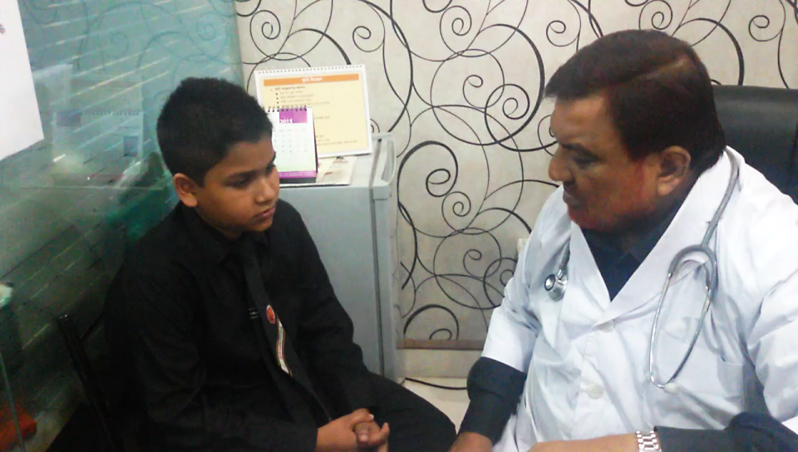
Notes:
1st suspension.

Slide 7
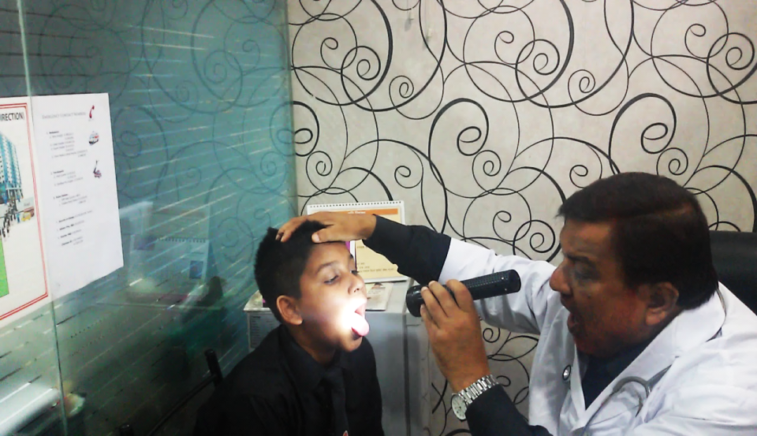
Notes:
2nd suspension.

Slide 8
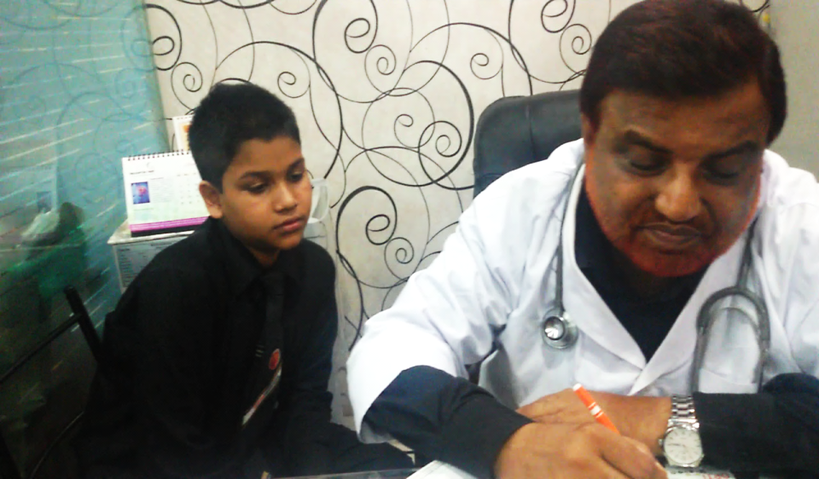
Notes:
3rd suspension.

Slide 9
What do you mean by the images?
A dialogue between
a doctor and a patient.
Notes:
Advance to lesson declaration.

Slide 10
Our today’s lesson is-
A dialogue between a doctor and a patient.
Notes:
Lesson Declaration.

Slide 11
Objectives
After completing this lesson, students will be able to---
make a dialogue with a doctor
share feelings with the doctor
make dialogues in other situations
Notes:
Speaking and listening skill will be focused.

Slide 12
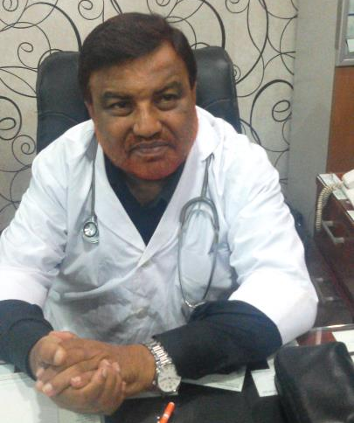
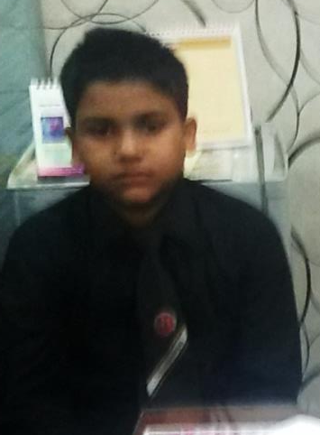
Patient
Doctor
Notes:
Introduction.of the doctor and the patient.

Slide 13
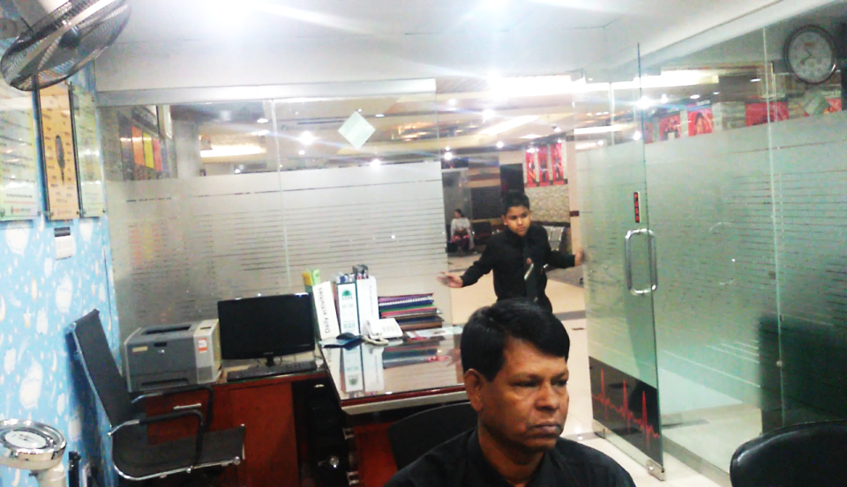
Assalamu Alaikum.
May I come in sir?
Notes:
Greeting slide of the patient.

Slide 14
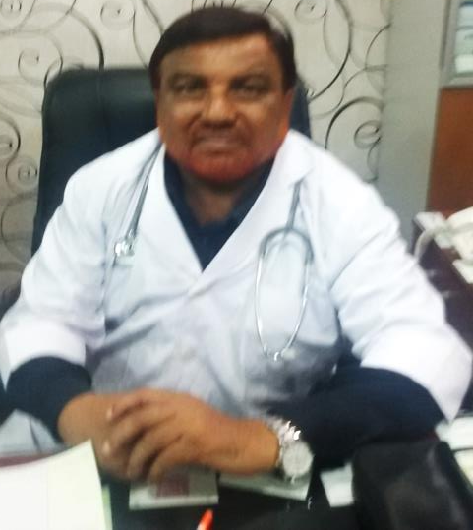
Walaikum Assalam.
Yes, come in.
Notes:
Doctor gives permission to go in.

Slide 15
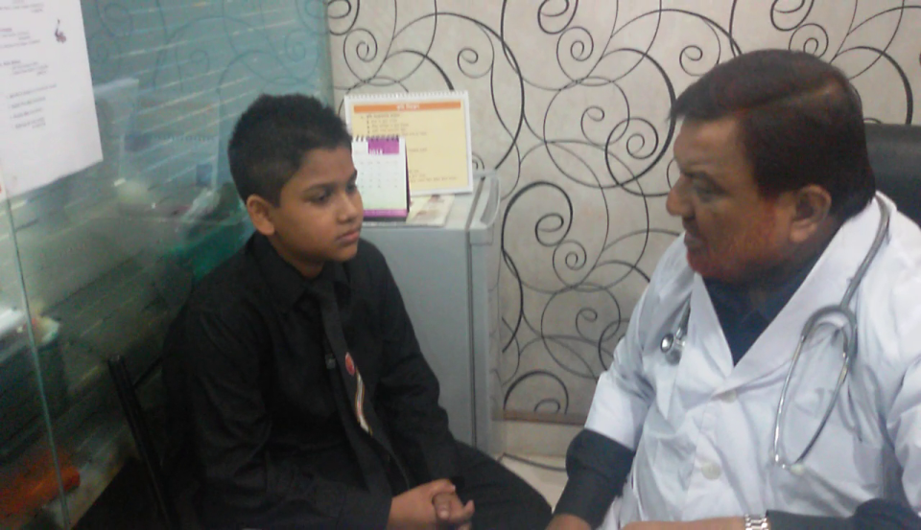
Thank you sir.

Slide 16
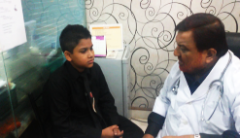
What is your problem?
I have caught cold.
Notes:
Main dialogue started.

Slide 17
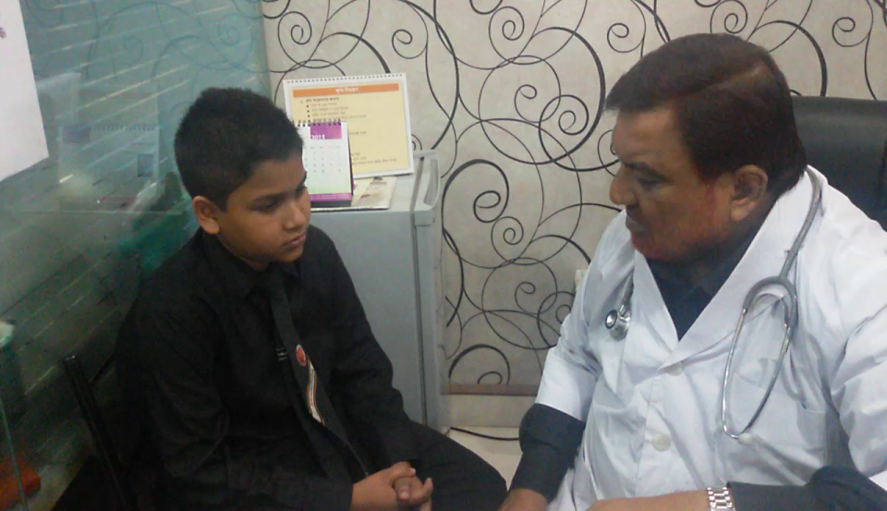
How long?
Four days.

Slide 18
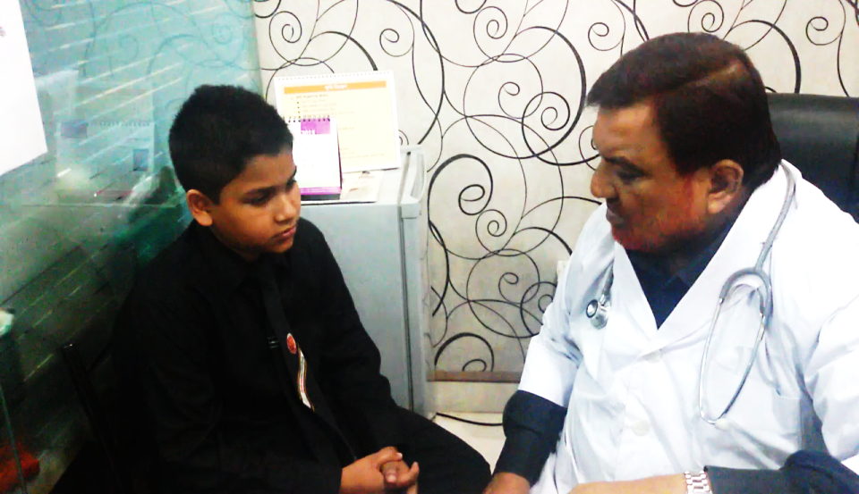
Did you go in rain?
Yes.

Slide 19
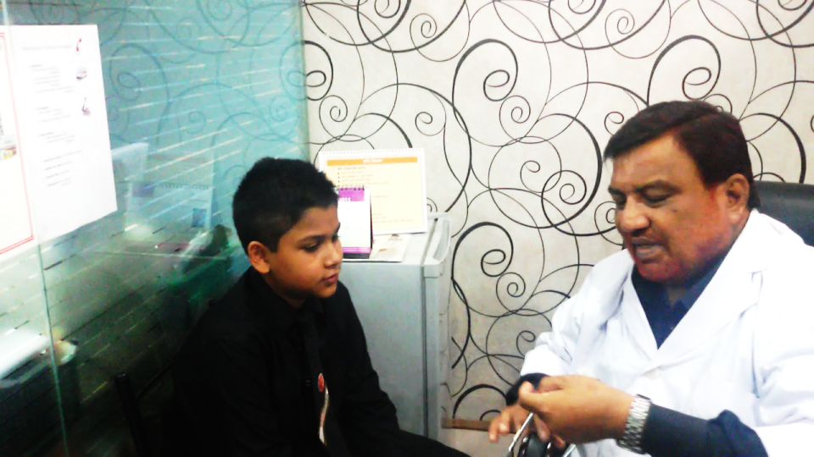
O,I see. This is the cause of your cold.
I also think so.

Slide 20
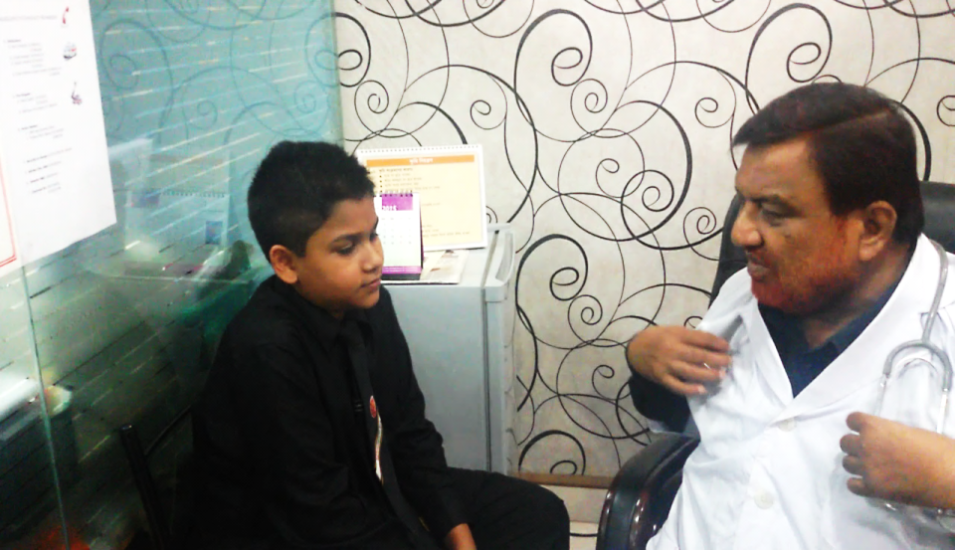
Don’t worry. Let me check you physically.
Ok sir.

Slide 21
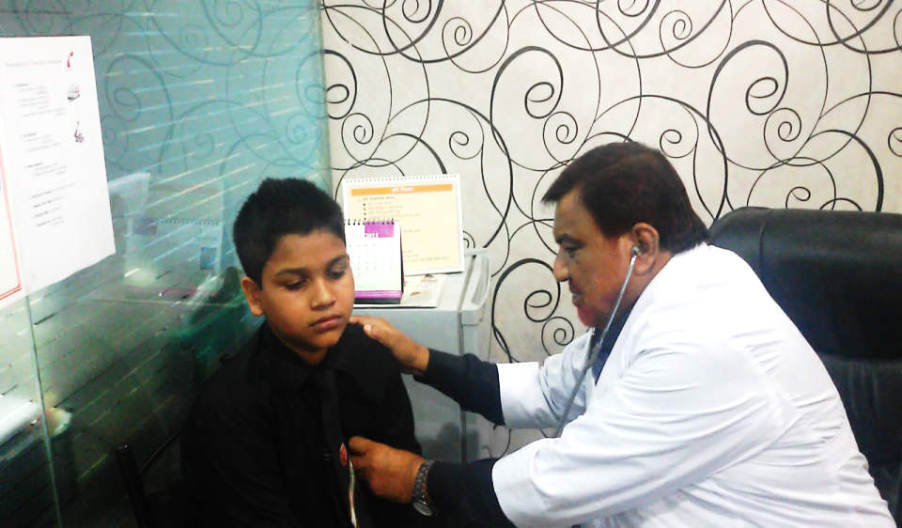
Breath long, again.
Ok doctor.

Slide 22
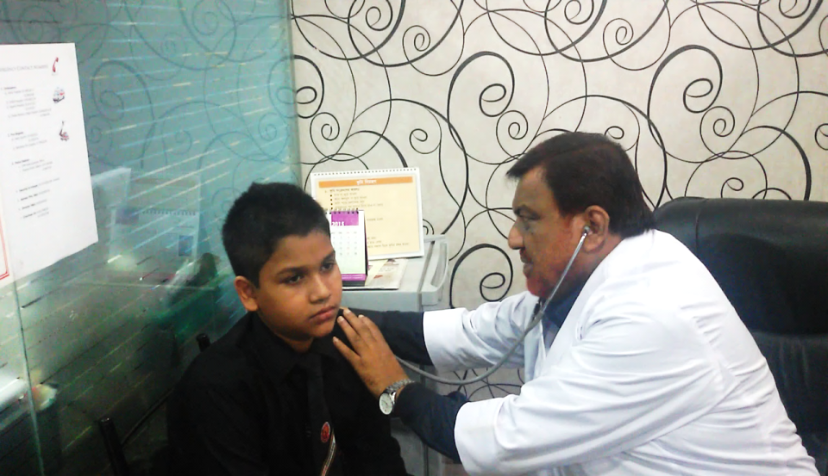
Let me see your back.
Ok sir.

Slide 23
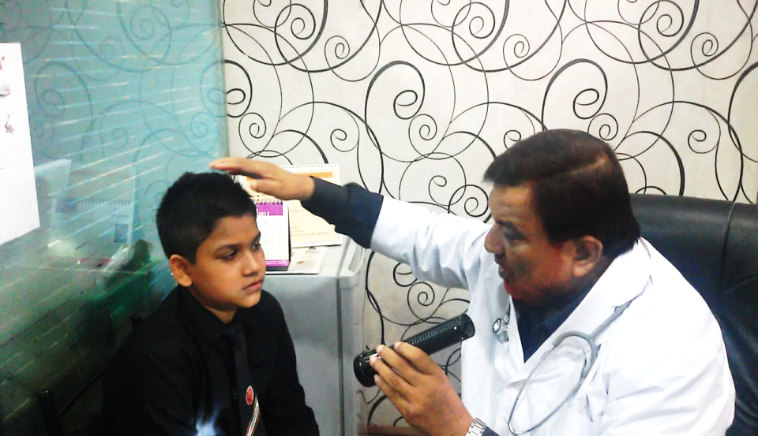
Open your mouth.
Sure sir.

Slide 24
Let me check your tongue.
Of course.

Slide 25
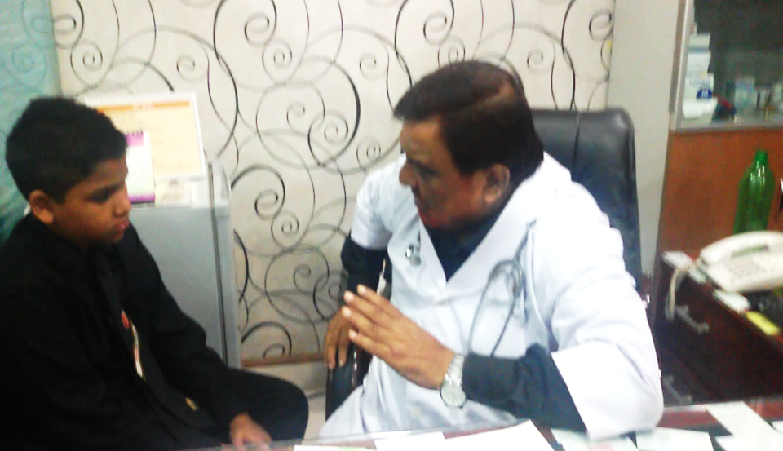
I am giving you some medicines. You will take them properly, Ok?
All right sir. Anything else?

Slide 26
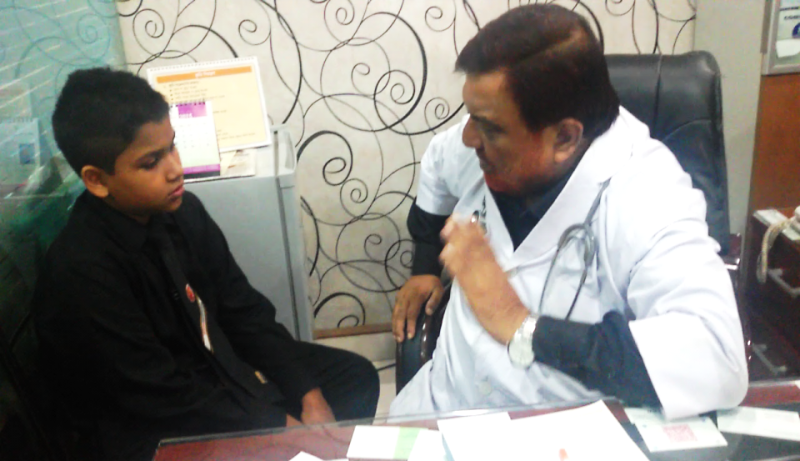
Don’t take any ice-cream or cold drink.
Ok sir. Thank you very much.

Slide 27
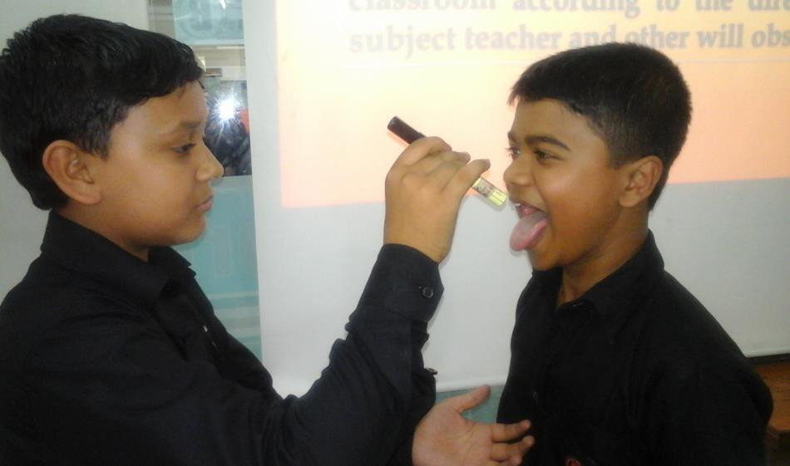
Pair Work
Several pair will act out the dialogue in the classroom according to the direction of the subject teacher and other will observe it.
Notes:
It is somewhat difficult to engage all the students in acting out dialogue. So it depends the teacher how many will be participated in acting.

Slide 28
Feedback
Suppose, you have caught cold and feeling unwell. You have gone to the doctor. Now write the dialogue you made with the doctor.
Notes:
Teacher may ask the students to write the dialogues in full as feedback.

Slide 29
Home Work
Suppose, you are a student of class VIII. Yesterday you went to a book shop to buy a book. Now write the dialogue with the book seller you made.
Notes:
This is for teaching the students to apply dialogue in real life situation.

Slide 30
Allah Hafez.
See you again.
Notes:
Ending slide.

